Slide 1
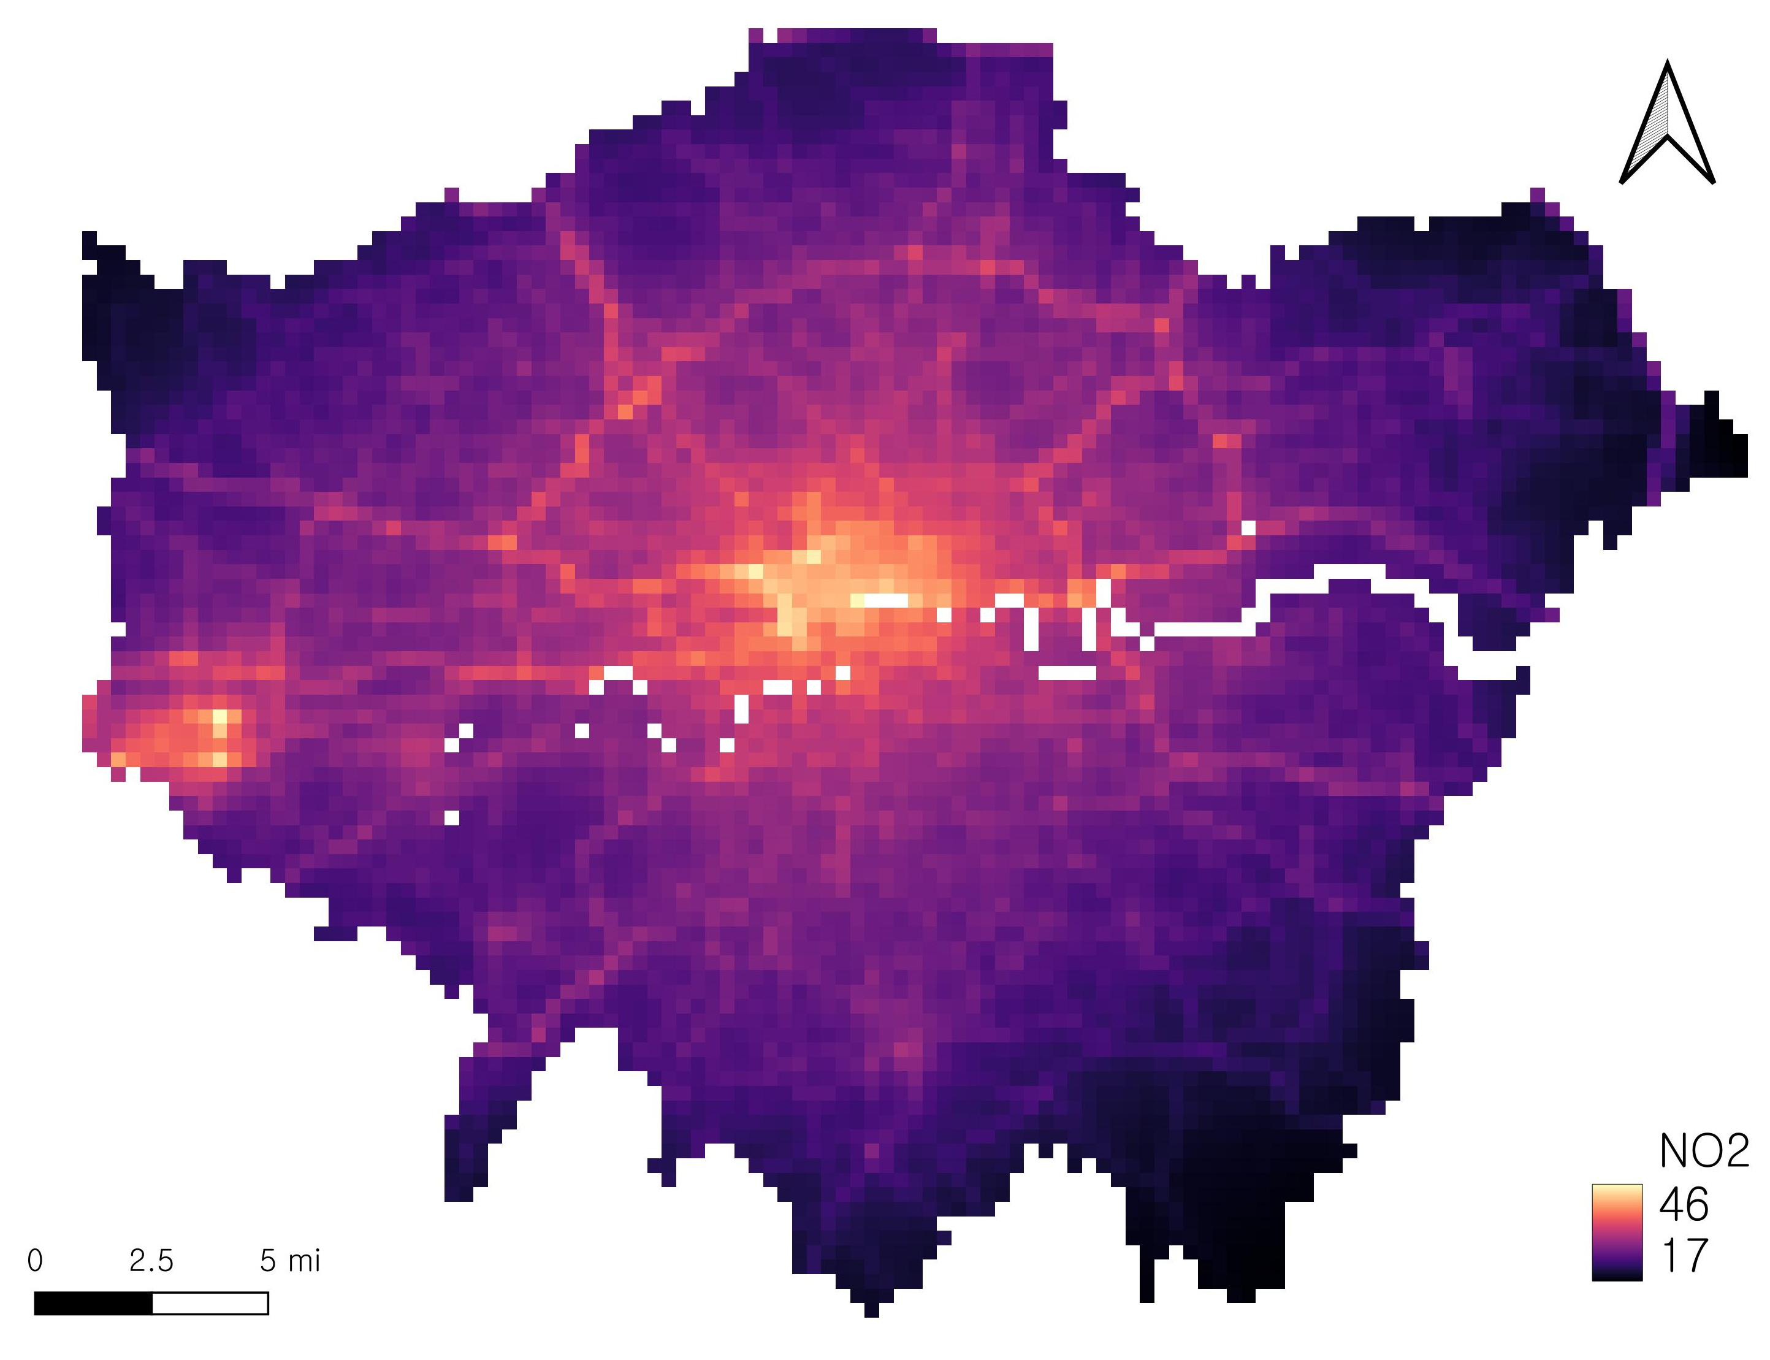
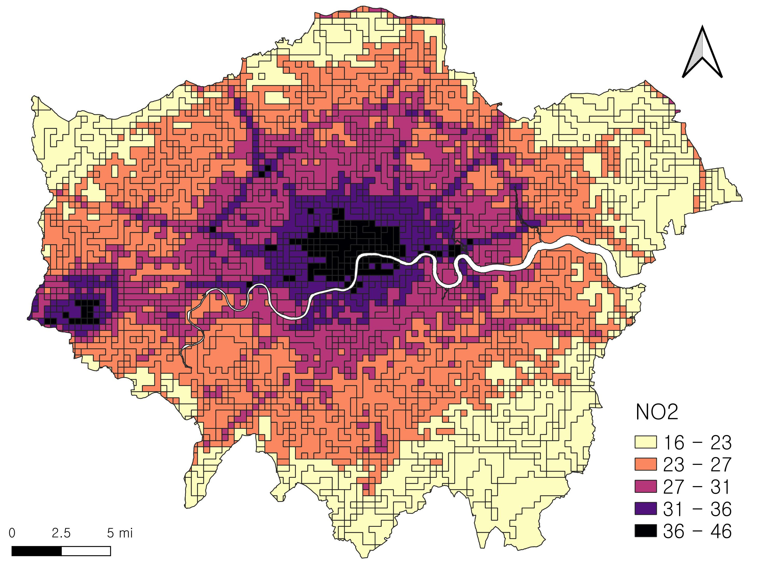
LAEI 2019 Emission
Converted to Vector and Classified by Jenks Breaks
then Weighted
Reprojected from 20m to 500m resolution
0%
5%
10%
20%
30%

